Slide 1

Traffic Violation Data Analysis
If You Torture the Data Long Enough, It Will Confess
~Ronald Coase

Slide 2

What is Data Analysis in Brief

Slide 3

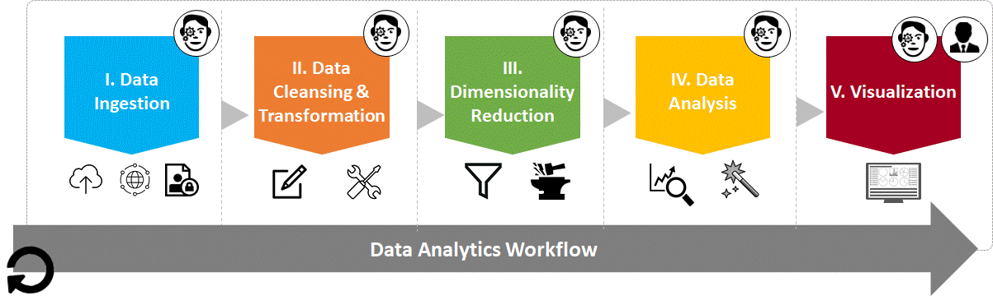
Data Analysis
Data analysis is a process of inspecting, cleansing, transforming, and modelling data with the goal of discovering useful information, and supporting decision-making.

Slide 4

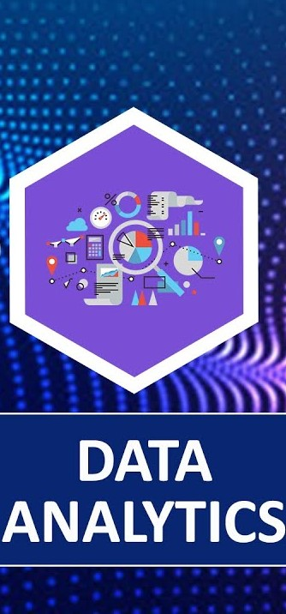
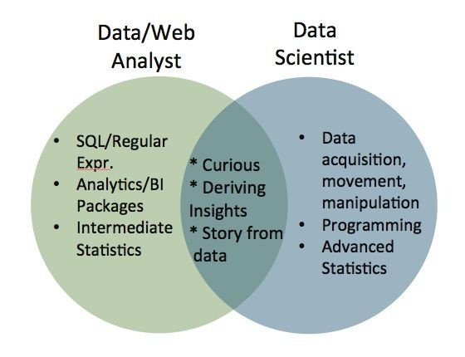
Difference between Data Analysis and Data Science
If data science is a home for all the methods and tools, data analytics is a small room in that house. Data analytics is more specific and concentrated than data science.

Slide 5
Comparison
Data Science
Data Analysis
focuses on discovering new questions that you might not have realized needed answering to drive innovation. Unlike data analytics which involves checking a hypothesis, data science tries to build connections and shapes the questions to answer them for the future.
involves answering questions generated for better business decision making. It uses existing information to uncover actionable data. Data analytics focuses on specific areas with specific goals.

Slide 6
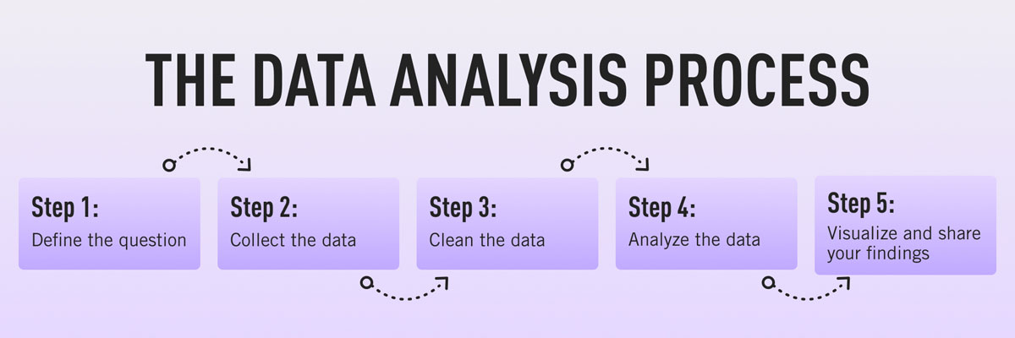

Slide 7
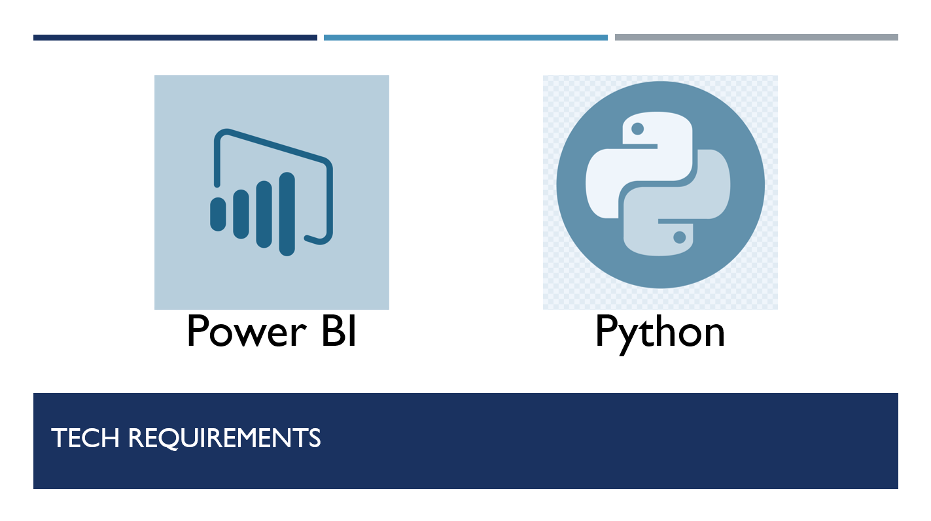

Slide 8
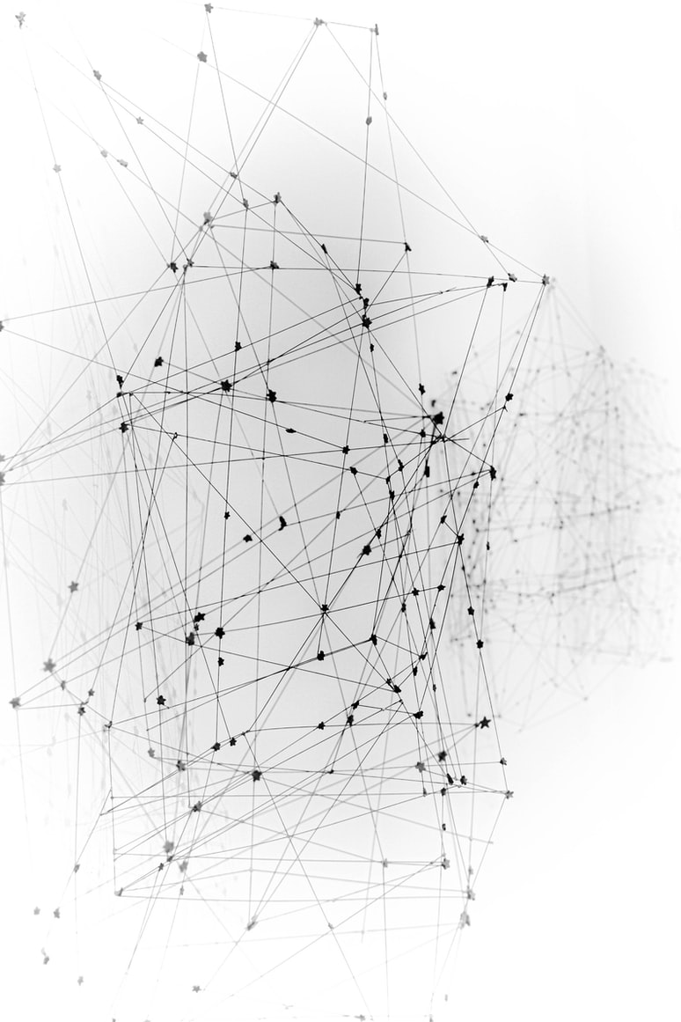
Thank You
Ahmad Younes
Oumama Nabaa
Ibrahim Hafez

